Slide 1
- A Profile BASHIR SONS ®
Engineering Services
Vol. 1, February, 2010

Slide 2
Who we are ?
BASHIR SONS has come a long way since our humble start a decade ago. Such phenomenal expansion in such a short time period has been achieved through hard work, devotion, to the cause and sincerity to the organization by our work force and management. In FY 2001-2002 our turnover stood at approximately Rs. 5 million while in FY 2008-2009 we crossed Rs. 250 million. We competed with the biggest names in the business and our finished works drew praise from our clients on most challenging projects.
Right now BASHIR SONS is actively engaged in major projects in Islamabad with diverse nature projects including, civil works, maintenance and renovations of multi-dimensional projects. We believe in quality work, always to the satisfaction of our patrons and expect our dedicated work force to achieve even higher levels of excellence, exemplary quality of work and maximum out put through flexible planning and efficient management.
BASHIR SONS has a vision to broaden its activity base to diversity into other infrastructure disciplines and achieve a healthy growth rate. The company has established its ability to deliver quality jobs within budget and schedule.
1

Slide 3
Contents
Our work is divided, but not limited to, in the following Divisions:
Wide range on turnkey basis
Security Division
Generators & UPS
Power Solution
Construction & Renovation
Civil Works
Maintenance, repairs & operation
Maintenance
Multinational, UN & Foreign Missions
Our Clients
Some of our recent projects
Snaps
Employee on pay-roll
Organization
2

Slide 4
Security Works Division
Our security work is further divided into the following 3-categories:
Access Control
Physical Security
Fortification
3-Tier security blanket around property
3

Slide 5
Security Works Division – Access Control
Access control is a system which enables an authority
to control access to areas in a given physical facility
Biometric
Burglar Alarm
Security Doors
Electronic Locks / Magnetic Stripe / Smart Cards
Photo Identification
Finger prints
4

Slide 6
Security Works Division – Physical Security
Physical security describes measures that prevent or
deter attackers from accessing a facility
Guards Tour Patrolling System
Security Control Centre
Security Alarms
CCTV Systems
Security Lights
Guard Houses
5

Slide 7
Security Works Division – Fortification
Fortification is a defensive structure build around a strong hold to deter
terrorism / enemy’s threat
HESCO Wall / Curtain wall
Road Blocker: Drop-down / Hydraulic / Bollards
Razor / Barbed / Entangle / Concertina Wires
Watch / Surveillance Towers / Turret
Ditch / Revetment / Parapet / Blockhouse
T-Wall / Steel re-enforced concrete wall
Sand-bag / Concrete Bunkers / Guard Posts
6

Slide 8
Power Solutions: Generators & UPS
Power Generators, AMF/ATS Panels and UPS of all international brands on turnkey basis
Sale
Installation
Leasing
Commissioning
Repairs
Testing
Maintenance
Purchase
7

Slide 9
Civil Works
Construction
Building construction
Heavy/civil construction
Industrial construction
Architectural drawings and designs
Renovation
Planning / Design
Engineering
Structural changes
Finishes
8

Slide 10
Maintenance
Repair
Maintenance
Service
Wears & Tears
Safety
Prevention
Plumbing
Electrical work
Carpentry
Polishing / Painting
Masonry
Welding
Heating / Cooling
Water Tanks Cleaning
Termite Treatment
Fumigation
Gas/Water Leakages
Sewerage Cleaning
Carpeting Cleaning
Sofa Cleaning
Washing Machine
Window/Split AC
Fridge/Freezer
Microwave
Gas oven
Dish washers
Satellite / Dish
9

Slide 11
Our Regular Clients
Multinationals
Embassies
UN & Int’l Organizations
Page
SHV
BP
Austrian Embassy
Denmark Embassy
Finland Embassy
Hungarian Embassy
Sri Lankan Embassy
IFES
UNDP
UNHCR
Private Individual
Pakistani Offices
BASHIR SONS providing its services to the entire satisfaction of these regular clients
Under construction
E C P
P T V
10

Slide 12
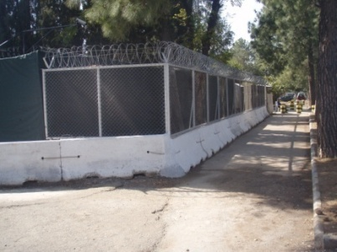
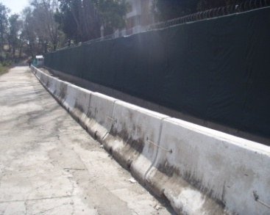
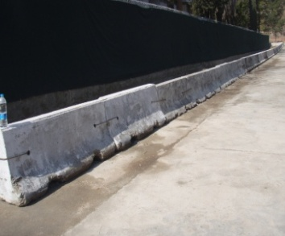
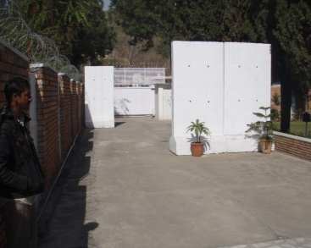
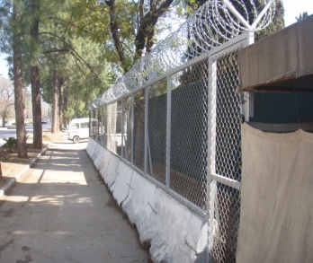
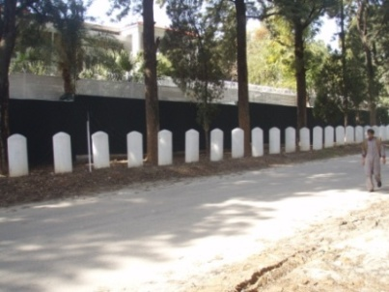
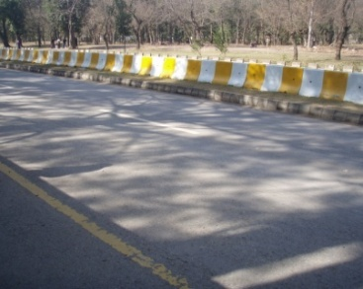
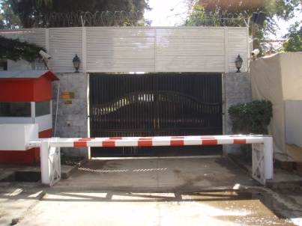
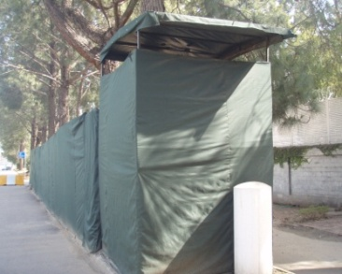
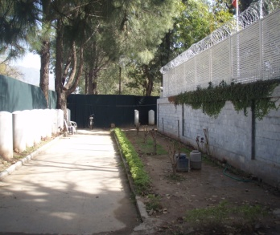
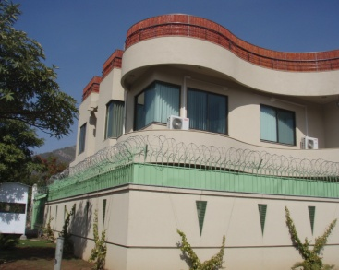
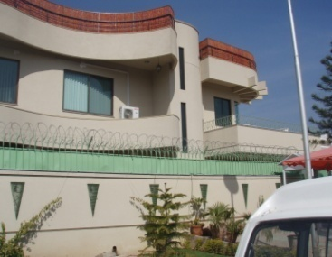
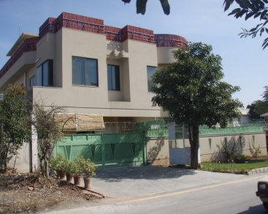
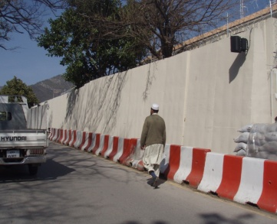
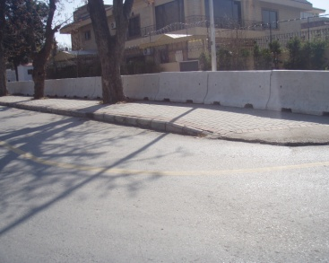
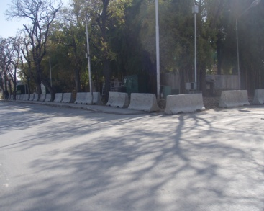
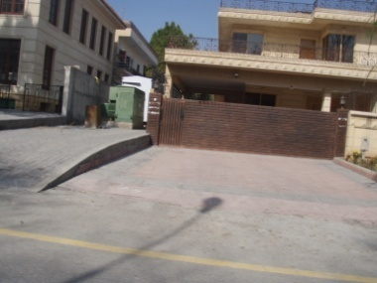
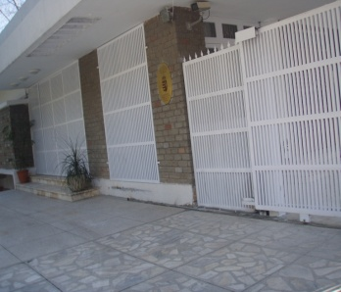
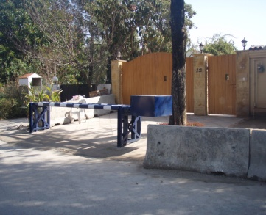
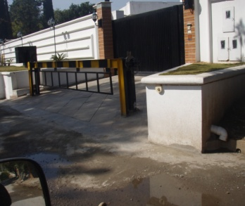
Snaps of our recently completed projects
11

Slide 13
Manpower (Regular Employees)
Managing Director
Director
(Works)
Director
(Operations)
Director
(Admin.)
Plumber x2
Electrician x2
Carpenter x2
Polisher/Painter x2
Mason x3
Welder x1
A/C Mechanic x2
Secretary x1
Supervisor x1
Accountant x1
Clerk x1
12

Slide 14
Work is our habit.
Thank You !
BASHIR SONS
Engineering Services
Address: Office No. 1, Block No. 2, F-6/1, Islamabad
Tel. Off. 051-28 77 254, Fax No. 051-28 77 354
Mobile nos. 0333-511 40 88, 0333 – 527 23 32 (24 hours)
E-mail: bashirsonspk@yahoo.com
Vol. 1, February, 2010

